Slide 1

Predicting movie ratings with multimodal data
Divya Velugula(11340384)
INFO 5082

Slide 2
Introduction:
Can we predict the success of a movie based on information about the ﬁlm available prior to theatrical release?
To answer this question, we use open-source multimodal data released by IMDB, such as movie posters and synopses. Imdb score is one of the important factor to measure the movie's success.
Our motivation for exploring this question is twofold. First, we aim to provide consumers with ﬁlm recommendations by predicting movie ratings accurately prior to theatrical release. Second, we hope to offer insight on the determining factors of ﬁlm ratings that will guide producers through ﬁlm promotion.

Slide 3
Statement of the problem:
Based on the massive movie information, it would be interesting to understand what are the important factors that make a movie more successful than others. So, we would like to analyze what kind of movies are more successful, in other words, get higher IMDB score.

Slide 4
Dataset used:
IMDB 5000 movie data.
It contains 28 variables for 5043 movies, spanning across 100 years in 66 countries. There are 2399 unique director names, and thousands of actors/actresses. “imdb_score” is the response variable while the other 27 variables are possible predictors.
The original dataset has been replaced in Kaggle, here’s the link for the original dataset from Data world:
https://data.world/data-society/imdb-5000-movie-dataset

Slide 5
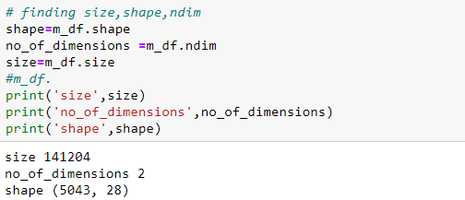
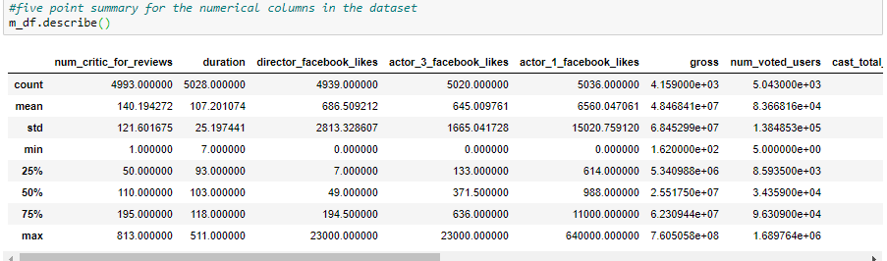
Exploratory Data Analysis(EDA):
The shape, size and ndim of the dataset is:
Null and missing values are removed where the count is less. Columns of now use are dropped.
Missing values for categorical variables are replaced with the highest frequency value and for numerical values, mean is used.
Languages column is dropped as 94% of the values is English. And countries is divided into 3 categories i.e., USA,UK and others.

Slide 6
Hypothesis Development:
Hypothesis testing is a statistical method that is used in making statistical decisions using experimental data.
We can evaluate two mutually exclusive statements about a population to determine which statement is best supported by the sample data.
Statement: Can we predict the success of a movie based on information about the film available prior to theatrical release?
Variables used to test the hypothesis : Number of voted users, Run time, title_year, gross and budget.

Slide 7
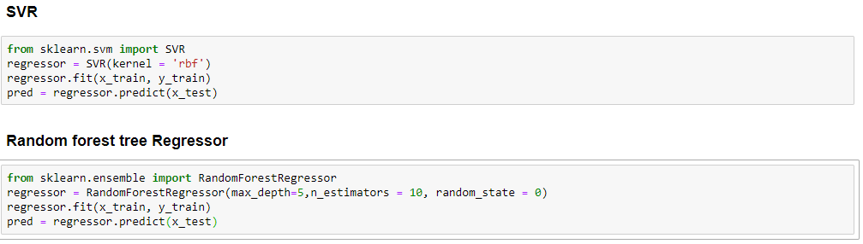
Method: Data Analysis:
Regression: The film rating prediction task is framed as regression, as the target variable(imdb_score) has continuous values.
Used SVR, Lasso, Decision tree and random forest. Out of all SVR and random forest performed best with best r^2 value.

Slide 8
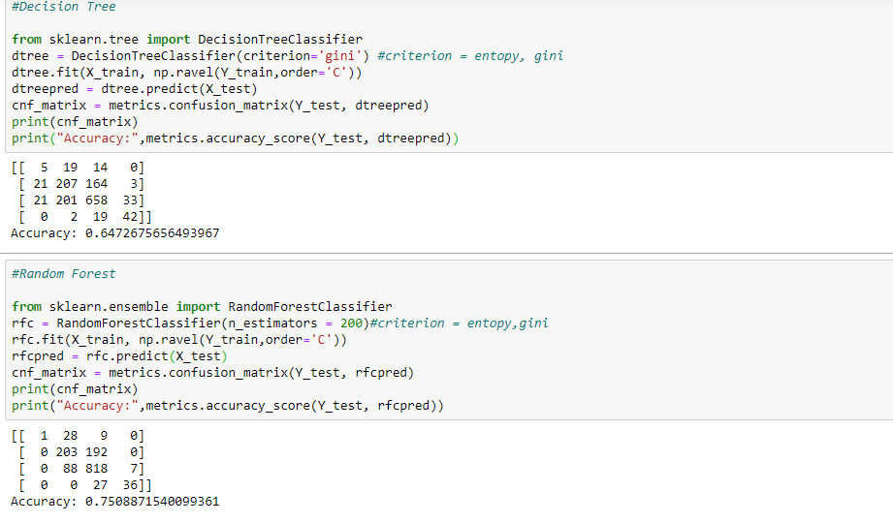
Method(Contd.):
Classification: For classification, the movie ratings were discretized as imdb_binned_score(target variable) as bad, average, good and excellent.
Here regression outperforms classification which we can clearly see from their accuracy and r^2 scores. For all the models, regression outperformed classification because discretizing data renders some information missing from the original data.

Slide 9
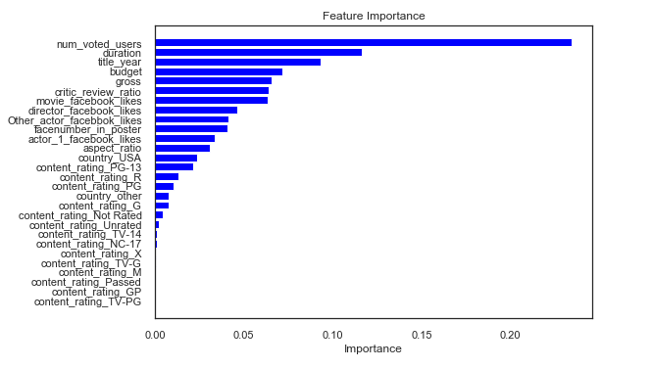
Method(Contd.): Feature representation & learning:
Feature importance determines the magnitude, not the direction of effect on movie ratings. Since random forest FI considers the importance of each individual feature, it assigns low scores to sparse feature columns. Thus, we used Feature importance to determine the predictive power of feature by all feature columns for every feature group and calculating the difference of the new and original full-model

Slide 10
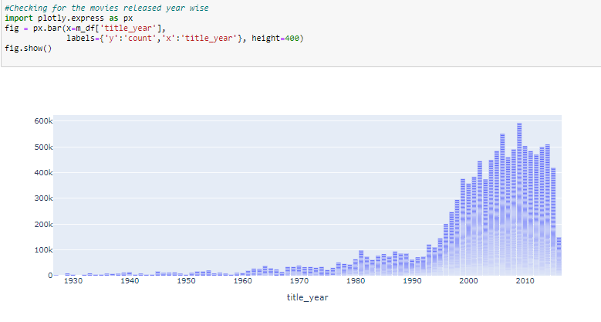
Method(Contd.): Data Visualization:
Movies released yearwise:

Slide 11
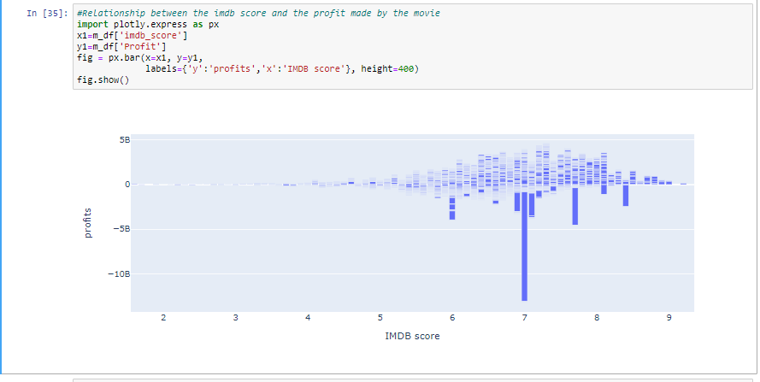
Method(Contd.): Data Visualization:
IMDB score vs. Profits:

Slide 12
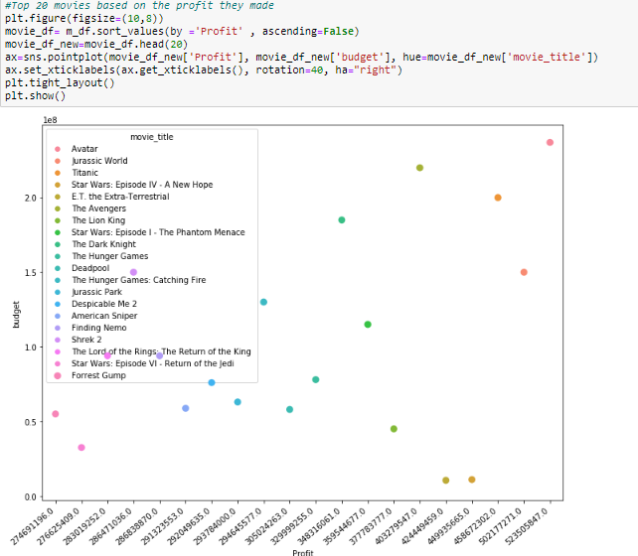
Method(Contd.): Data Visualization:
Top 20 movies based on the profit they made:

Slide 13
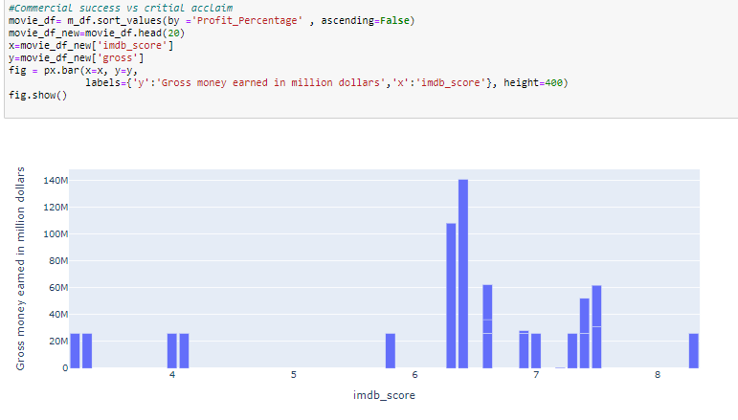
Method(Contd.): Data Visualization:
Commercial success vs critical acclaim:

Slide 14
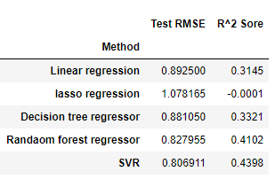
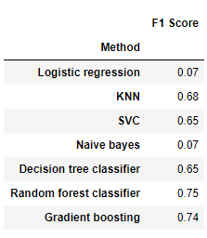
Decision Making & Data Interpretation:
Regression:
Classification:
SVR and random forest regression have similar R2, but SVR is significantly slower and harder to interpret. Considering accuracy, efficiency and interpretability, random forest was our best model.

Slide 15
Conclusion:
By feeding information available prior to theatrical release into a random forest model, we could explain high variance in English language movie ratings, better than other models that depend only on information prior to theatrical release.
Among all the features, number of voted users had the highest predictive power for film ratings followed by duration (run time) ,title_year, gross and budget.
Thus, production companies and consumers should consider various combinations of voted users for movie production and choice.

Slide 16
Future work:
Adding new features, such as movie trailers, could help improve our film rating prediction.
Another area for future research is the development of a sophisticated nested model to better combine information from all three feature categories.

Slide 17

Thank you

